Slide 1

Lecture 7: Other NoSQL Databases
Prof. Dr. Taysir Hassan Abdel Hamid
Professor,
Information Systems Department,
Faculty of Computers and Information
Assiut University
April 7, 2024

Slide 2
Agenda
Graph NoSQL databases ○ Neo4J

Slide 3
From Previous Lecture: Types of NoSQL Databases
Here is a limited taxonomy of NoSQL databases:
NoSQL Databases
Document Stores
Graph Databases
Key-Value Stores
Columnar Databases

Slide 4
II. Graph NoSQL Databases

Slide 5
Graph NoSQL Datatabases
A graph database is a type of NoSQL database that is designed to handle data with complex relationships and interconnections.
In a graph database, data is stored as nodes and edges, where nodes represent entities and edges represent the relationships between those entities.

Slide 6
Graph databases are particularly well-suited for applications that require deep and complex queries, such as social networks, recommendation engines, and fraud detection systems.
They can also be used for other types of applications, such as supply chain management, network and infrastructure management, and bioinformatics.

Slide 7
Advantages of Graph Databases
One of the main advantages of graph databases is their ability to handle and represent relationships between entities.
This is because the relationships between entities are as important as the entities themselves, and often cannot be easily represented in a traditional relational database.
High Flexibility. Graph databases can handle data with changing structures and can be adapted to new use cases without requiring significant changes to the database schema.
High performance: Graph databases are optimized for handling large and complex datasets, making them well-suited for applications that require high levels of performance and scalability.
Scalability: Graph databases can be easily scaled horizontally, allowing additional servers to be added to the cluster to handle increased data volume or traffic.
Easy to use: Graph databases are typically easier to use than traditional relational databases. They often have a simpler data model and query language, and can be easier to maintain and scale.

Slide 8
Disadvantages
Graph databases may not be suitable for all applications.
For example, they may not be the best choice for applications that require simple queries or that deal primarily with data that can be easily represented in a traditional relational database.
Additionally, graph databases may require more specialized knowledge and expertise to use effectively.
Too complex relationships

Slide 9
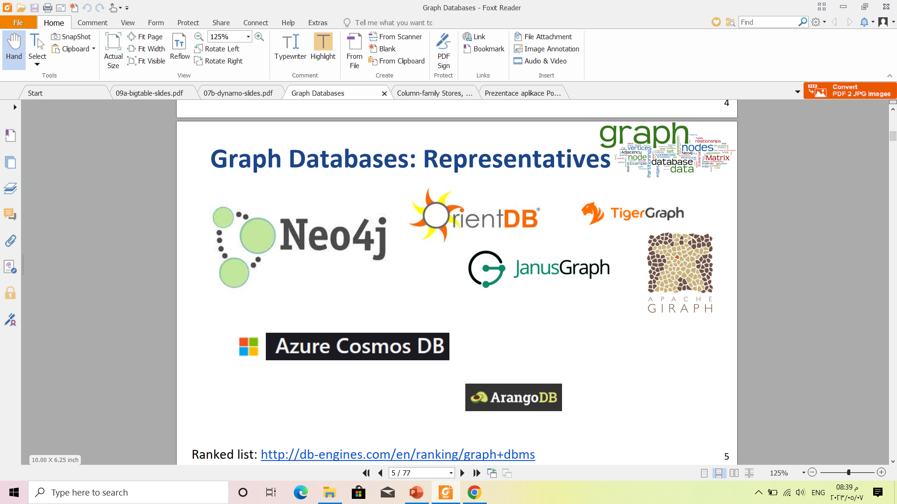

Slide 10
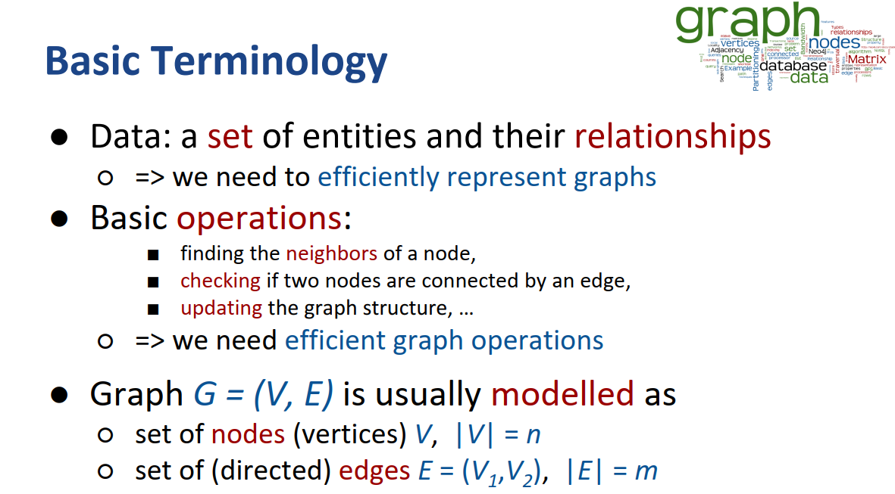

Slide 11
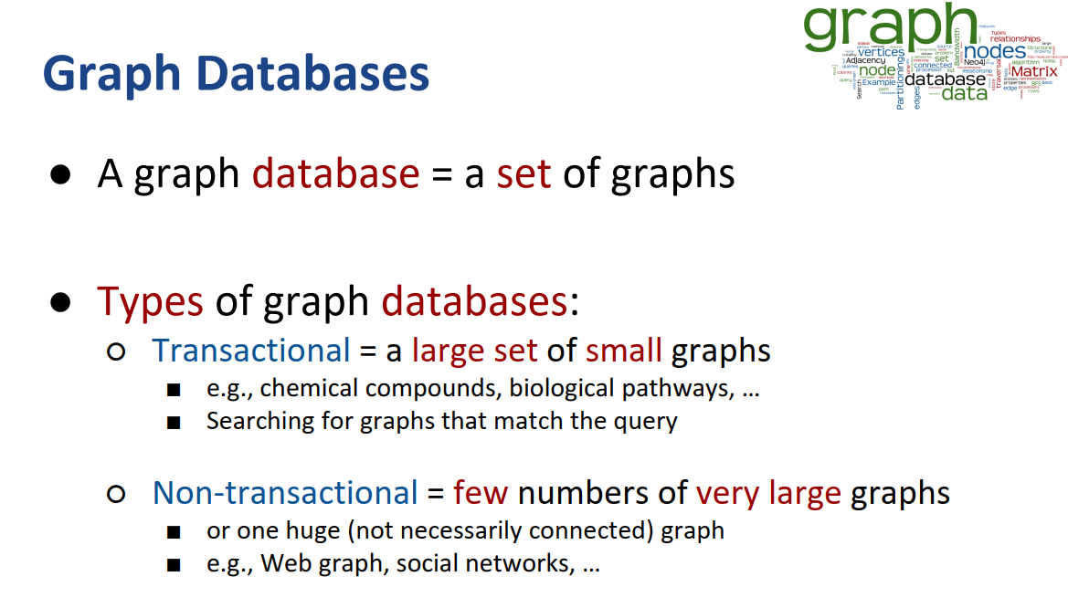

Slide 12
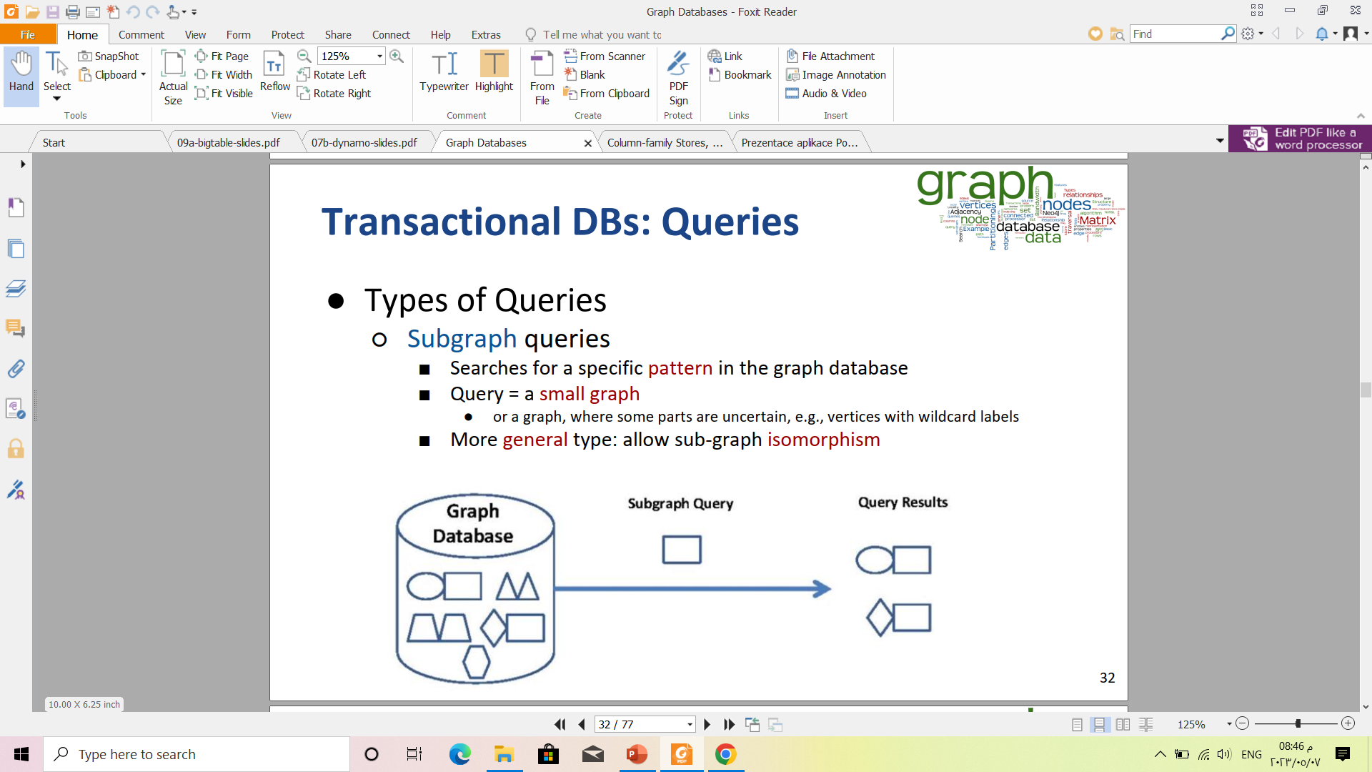

Slide 13
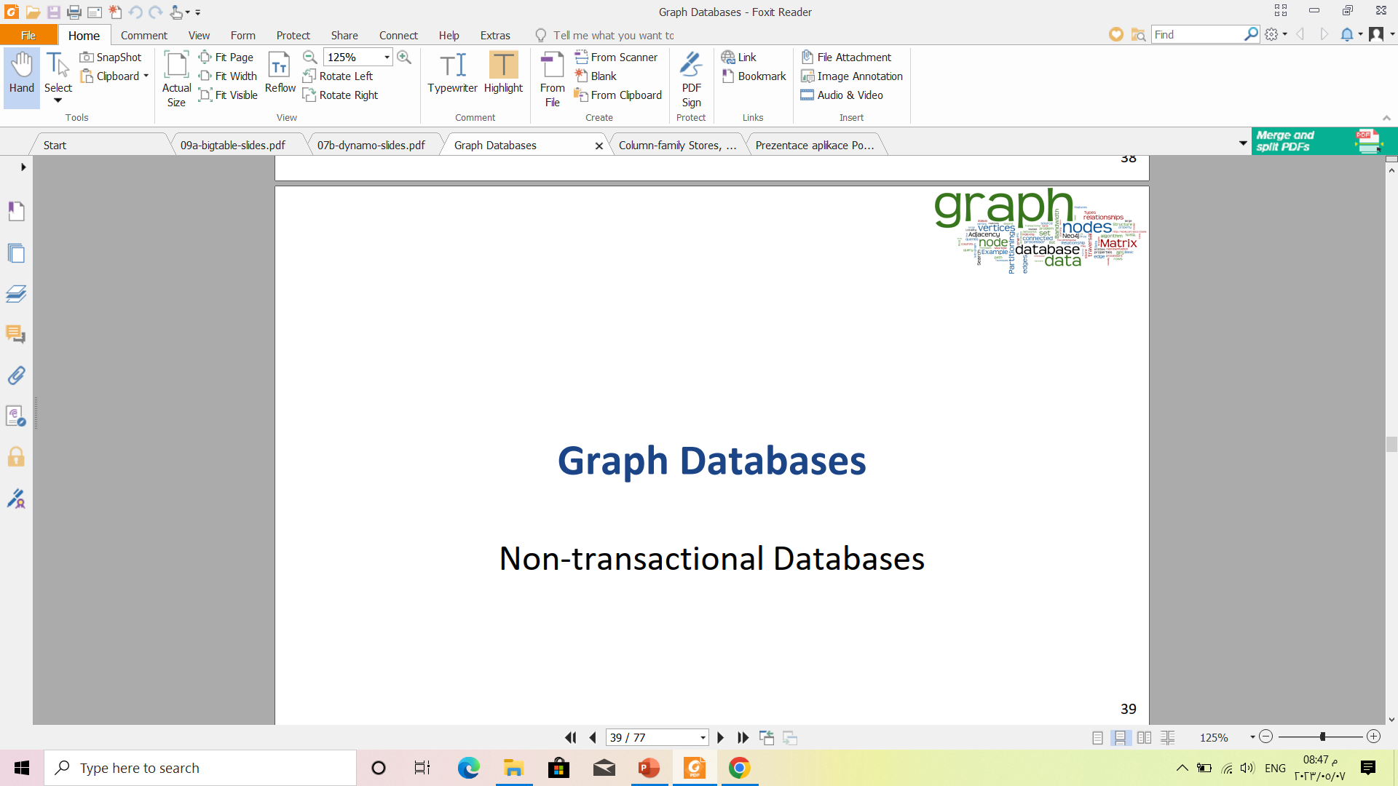

Slide 14
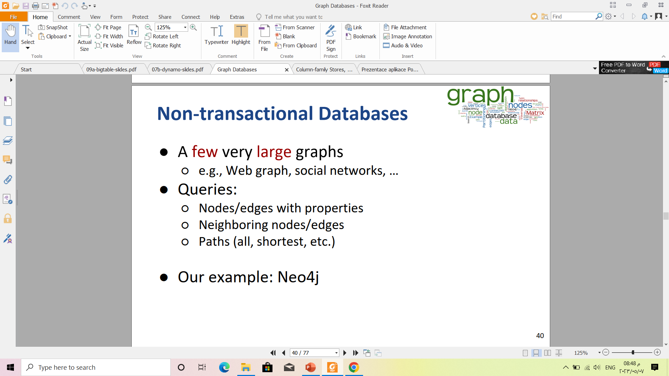

Slide 15
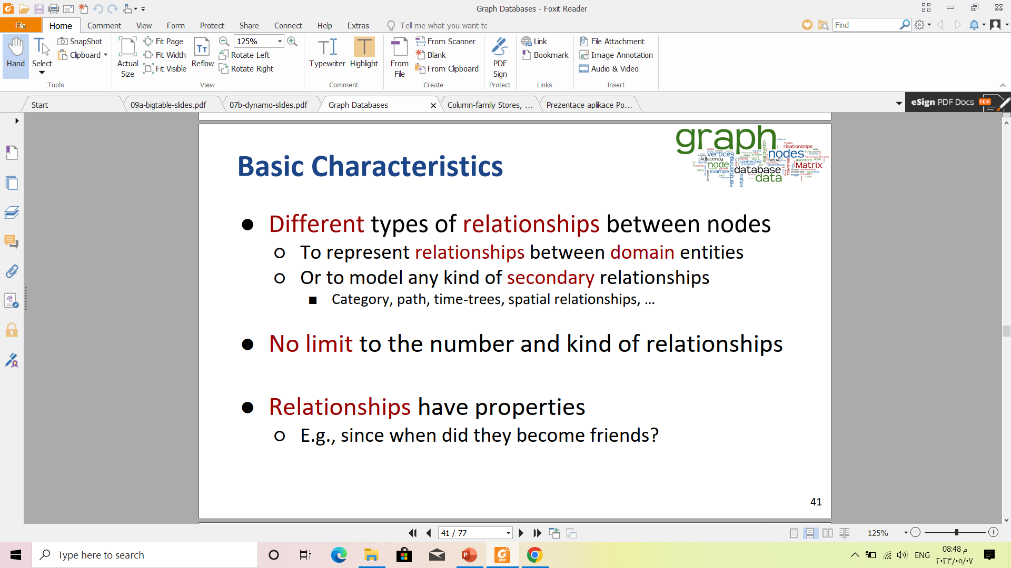

Slide 16




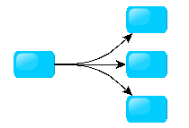
Different Kinds of Graphs
Undirected Graph
Directed Graph
Pseudo Graph
Multi Graph
Hyper Graph
Notes:
An undirected graph is one in which edges have no orientation. The edge (a, b) is identical to the edge (b, a).
A directed graph or digraph is an ordered pair D = (V, A)
A pseudo graph is a graph with loops
A multi graph allows for multiple edges between nodes
A hyper graph allows an edge to join more than two nodes

Slide 17

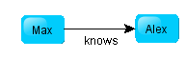
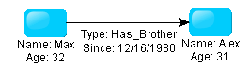
More Kinds of Graphs
Weighted Graph
Labeled Graph
Property Graph
Notes:
A weighted graph has a number assigned to each edge
A labeled graph has a label assigned to each node or edge
A property graph has keys and values for each node or edge

Slide 18
What is a Graph Database?
A database with an explicit graph structure
Each node knows its adjacent nodes
As the number of nodes increases, the cost of a local step (or hop) remains the same
Plus an Index for lookups

Slide 19
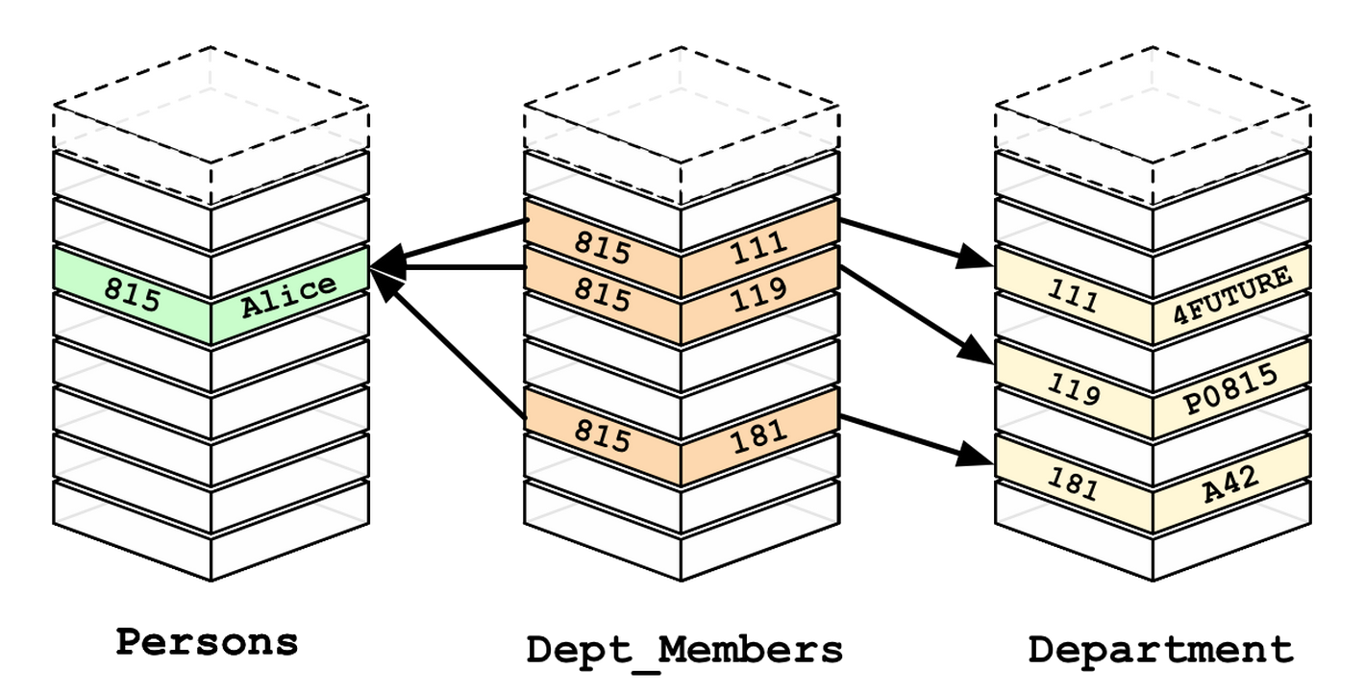
Relational Databases

Slide 20
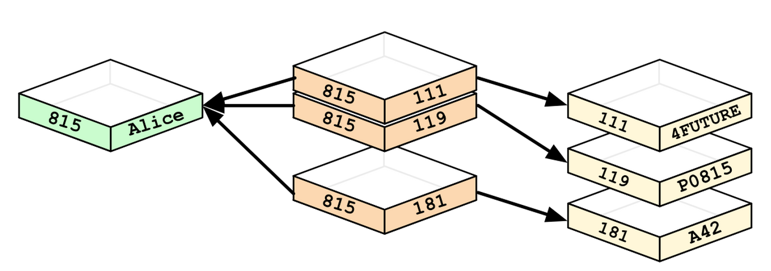
Graph Databases

Slide 21
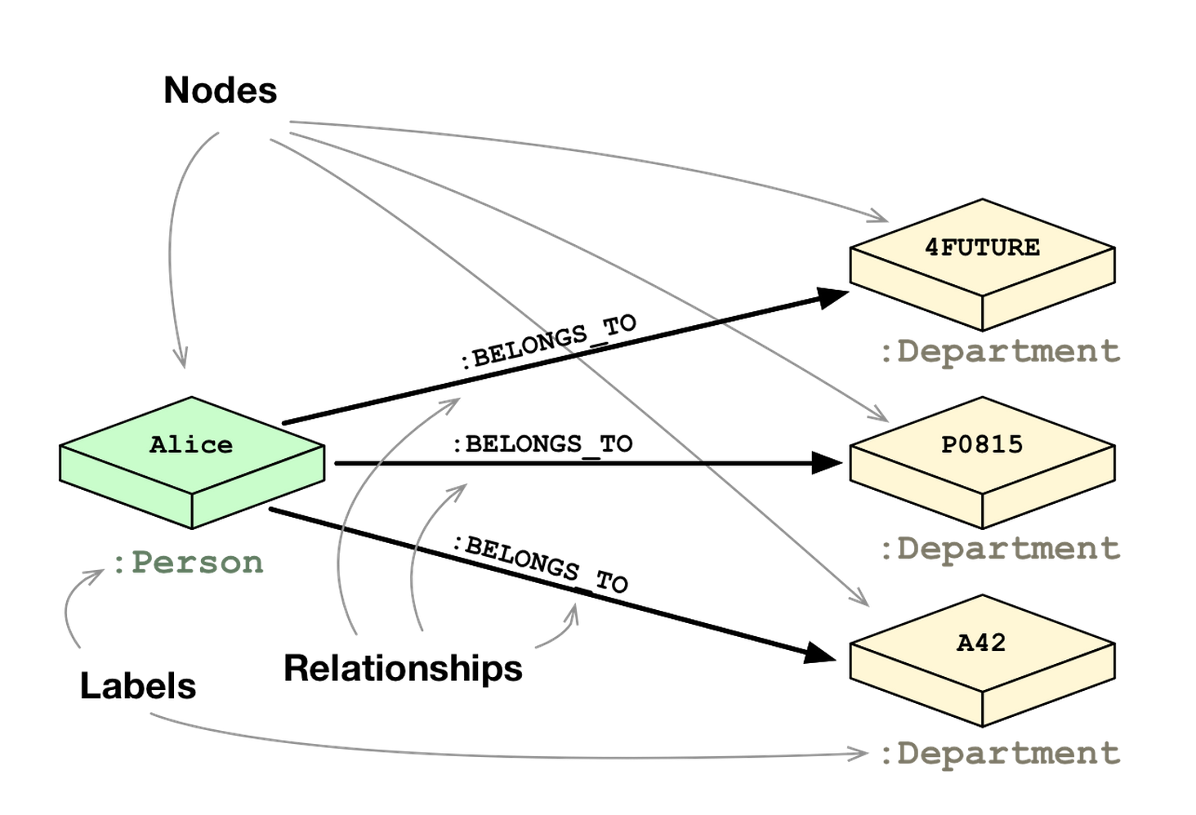

Slide 22
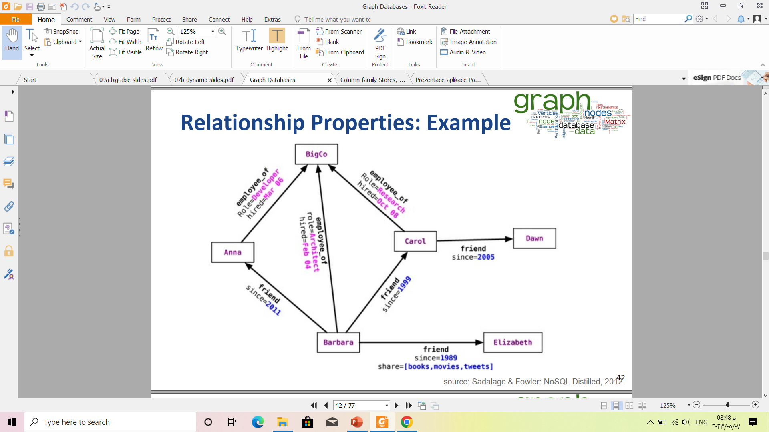

Slide 23
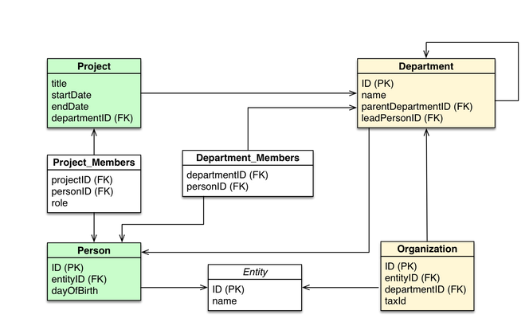

Slide 24
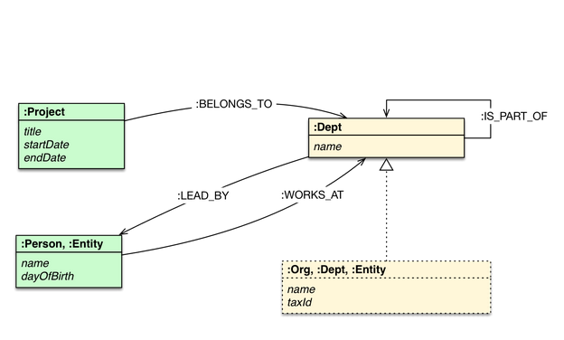

Slide 25
Neo4j Tips
Open source system
Uses concepts of nodes and relationships
Each entity table is represented by a label on nodes
Each row in a entity table is a node
Columns on those tables become node properties.
Somewhat similar to ER/EER concepts
Join tables are transformed into relationships, columns on those tables become relationship properties
Part of high-level declarative query language Cypher

Slide 26
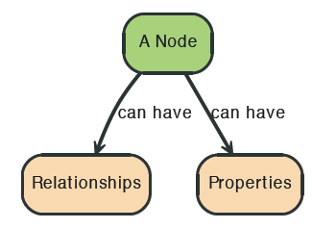
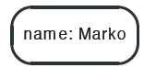
Node in Neo4j

Slide 27
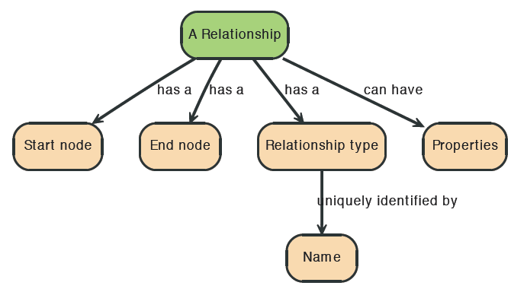
Relationships in Neo4j
Relationships between nodes are a key part of Neo4j.

Slide 28
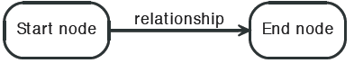

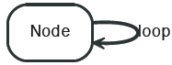
Relationships in Neo4j

Slide 29
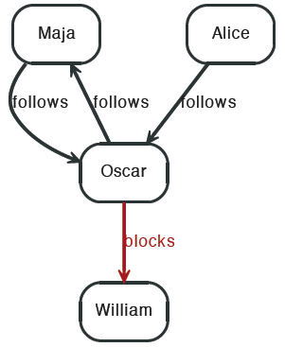


Twitter and relationships

Slide 30
Properties
Both nodes and relationships can have properties.
Properties are key-value pairs where the key is a string.
Property values can be either a primitive or an
array of one primitive type.
For example String, int and int[] values are valid for properties.

Slide 31
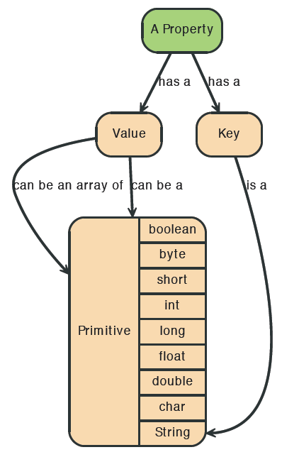
Properties

Slide 32
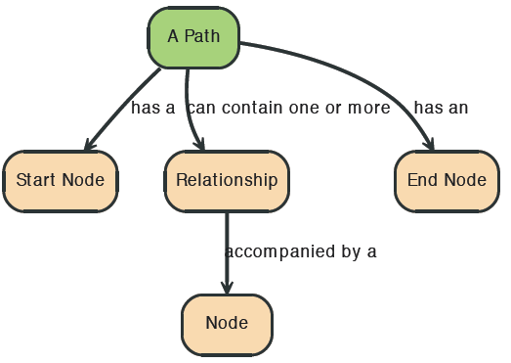
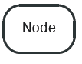
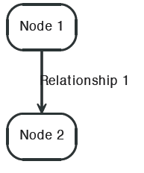
Paths in Neo4j
A path is one or more nodes with connecting relationships, typically retrieved as a query or traversal result.

Slide 33
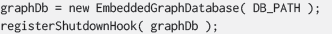

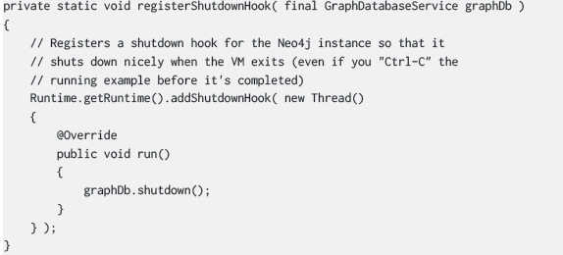
Starting and Stopping

Slide 34
From Previous Lecture: Types of NoSQL Databases
Here is a limited taxonomy of NoSQL databases:
NoSQL Databases
Document Stores
Graph Databases
Key-Value Stores
Columnar Databases

Slide 35
III. Key-value Stores NoSQL Databases

Slide 36
From Previous Lecture: Types of NoSQL Databases
Here is a limited taxonomy of NoSQL databases:
NoSQL Databases
Document Stores
Graph Databases
Key-Value Stores
Columnar Databases

Slide 37
IV. Columnar NoSQL Databases

Slide 38
Thank You

